Slide 1

Microsoft Azure Stack Hub Hybrid Applications
Building a hybrid cloud environment
This work is licensed under a Creative Commons Attribution - ShareAlike 4.0 International Public License

Slide 2
Agenda
Azure Stack Hub Enables Hybrid Solutions
Basics of ARM
Azure Stack Hub Solution Architectures
Hybrid Application Tutorials
Tooling and developer tips
Environments / Endpoints / API Versions

Slide 3

Azure Stack Hub Enables Hybrid Solutions

Slide 4







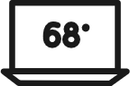






















Microsoft worldview
Intelligent Cloud
Intelligent Edge

Slide 5

Intelligent cloud and intelligent edge
a
b
c
d
e
Intelligent cloud
Intelligent edge
Ubiquitous computing enabled by public cloud and AI
Powers every type of intelligent application and system
A set of connected systems and devices
Gather and analyze information close to the physical world
Deliver real-time insights and immersive experiences that are highly responsive and contextually aware

Slide 6





Azure Stack Hub
Complete autonomous cloud
Only consistent hybrid cloud that can run at the connected or disconnected
Edge & Disconnected
Cloud application model
Common application model, tools and APIs with Azure simplifying DevOps
Regulatory & Data Sovereignty
Azure Services & Marketplace
Azure web services, containers, Azure Functions, & Azure Marketplace
Application Modernization
Integrated System
cloud inspired infrastructure via integrated systems from major H/W partners

Slide 7





Hybrid has many forms
Matching resources on both Clouds
Resources spread across Clouds
Using public endpoints for connectivity
Seamless connectivity across Clouds

Slide 8
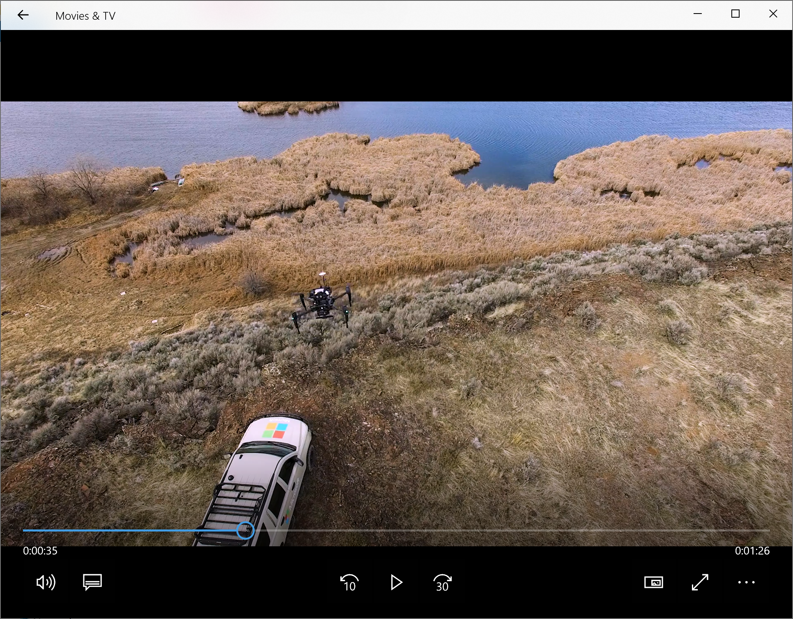
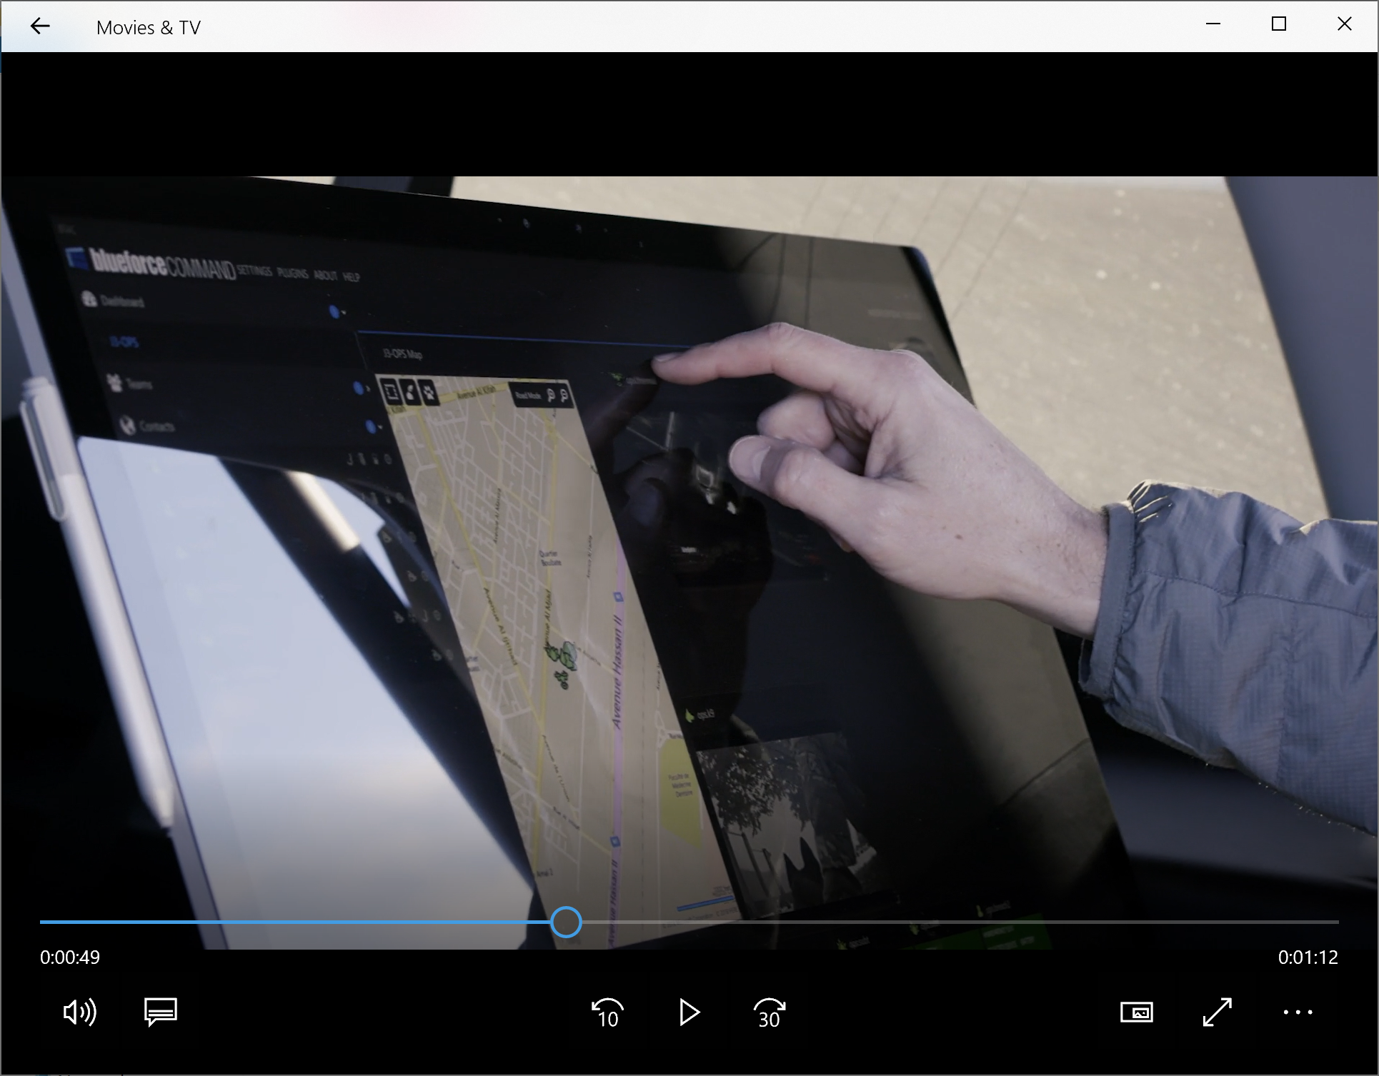
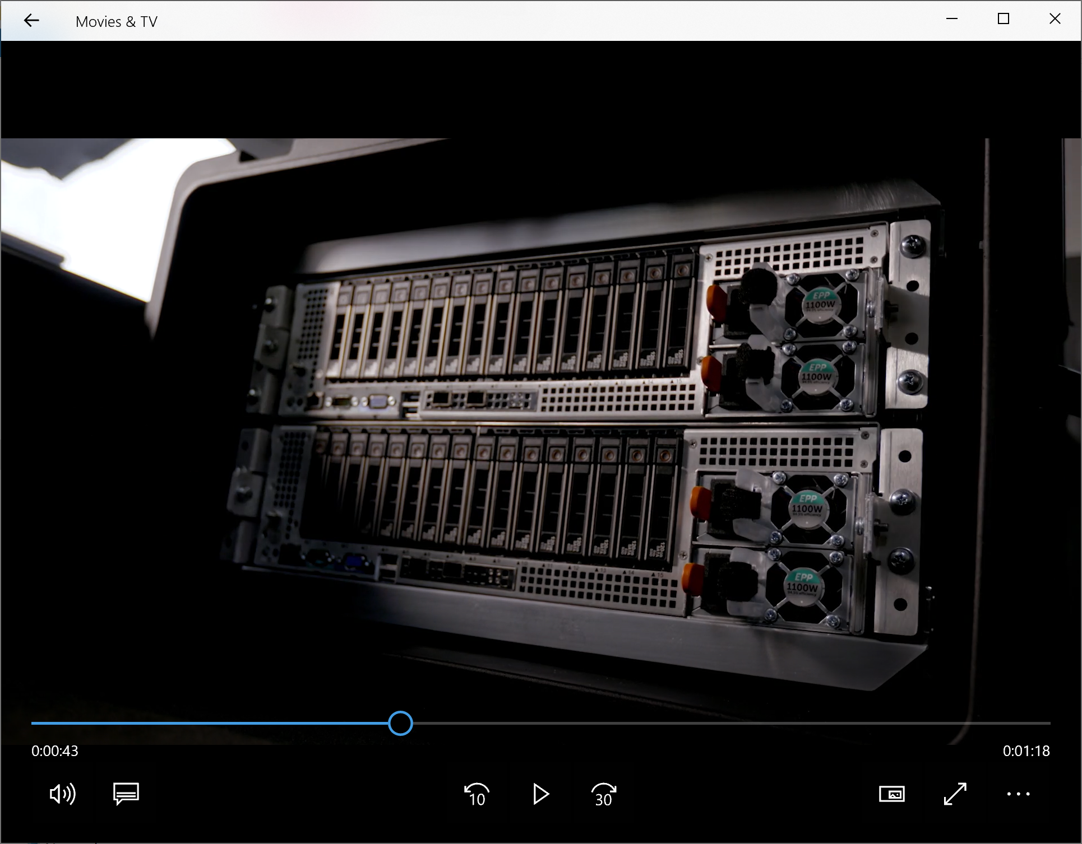
Hybrid enables a new breed of applications
In harsh environments
Insights where the action happens
New form factors

Slide 9
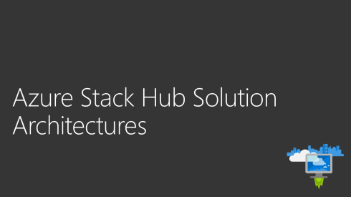

Basics of ARM
Do we need a recap?
If not, let’s skip ahead – click here:

Slide 10

Azure Stack Hub promise
Consistent
application development
Azure services
available on-premises
Integrated
delivery experience

Slide 11
Azure Resource Manager
Describe
Deploy
Control
RESOURCE
GROUP
Azure Resource Manager
Azure Resource Manager
App
Database
Compute
Network
Storage
Consistency
MICROSOFT Azure Stack Hub
MICROSOFT AZURE

Slide 12
Complex deployments using resource groups

Slide 13
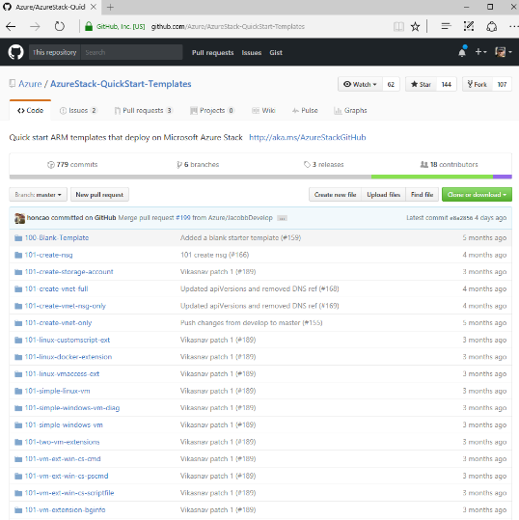

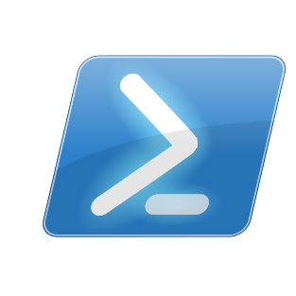
ARM provides consistency across environments
Quick Start ARM Templates
Virtual Machine (Azure)
Azure PowerShell
Virtual Machine (Azure Stack Hub)

Slide 14

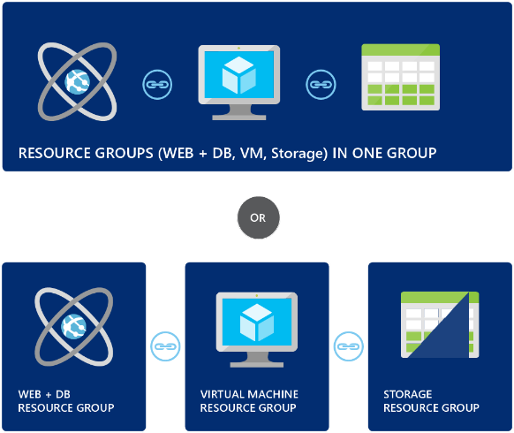

ARM enables hybrid deployments too!
Azure
Azure Stack Hub
VPN
SDK/CLI
Hybrid app design considerations in Azure and Azure Stack Hub - Azure Hybrid App Solutions | Microsoft Docs

Slide 15
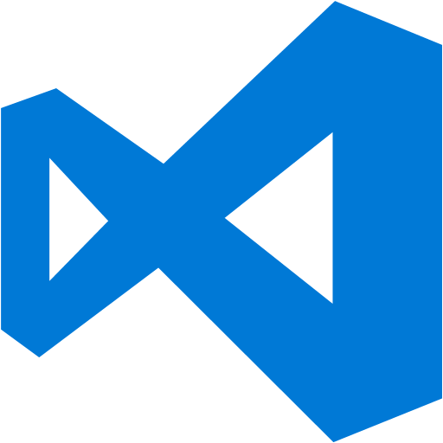






Hybrid deployment considerations – Differences between Azure and Azure Stack Hub
2016-03-01
2015-08-01
Endpoints
API versions
Capabilities
Content

Slide 16
Azure Stack Hub Solution Architectures

Slide 17

Accelerating Azure Stack Hub usage with patterns
Microsoft has documented a set of multiple hybrid solution architectures for Azure Stack Hub and Azure – hybrid connectivity, identity, networking, and CI/CD pipeline.
They are the basis for a set of more detailed sample hybrid cloud solutions that you can use as references to build out similar solutions using both Azure Stack Hub and Azure.

Slide 18
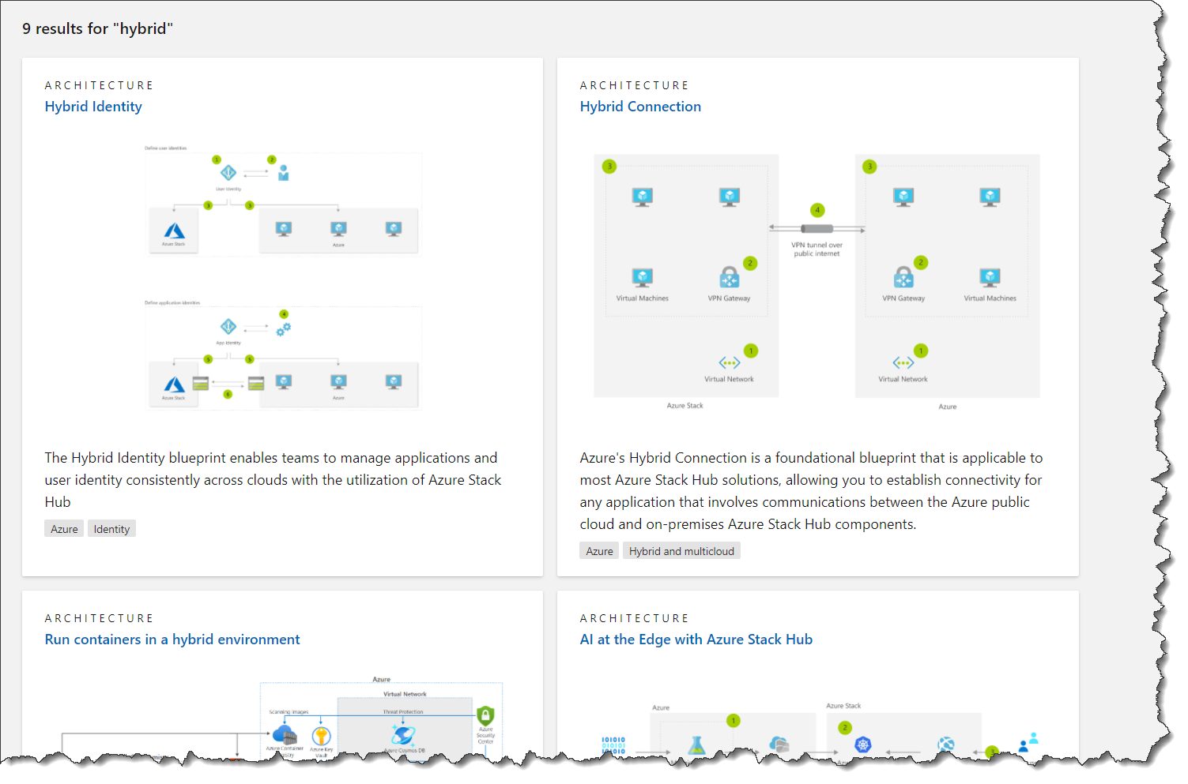
Foundational patterns for Azure Stack Hub
Azure Stack Architectures - Azure Architecture Center | Microsoft Docs

Slide 19
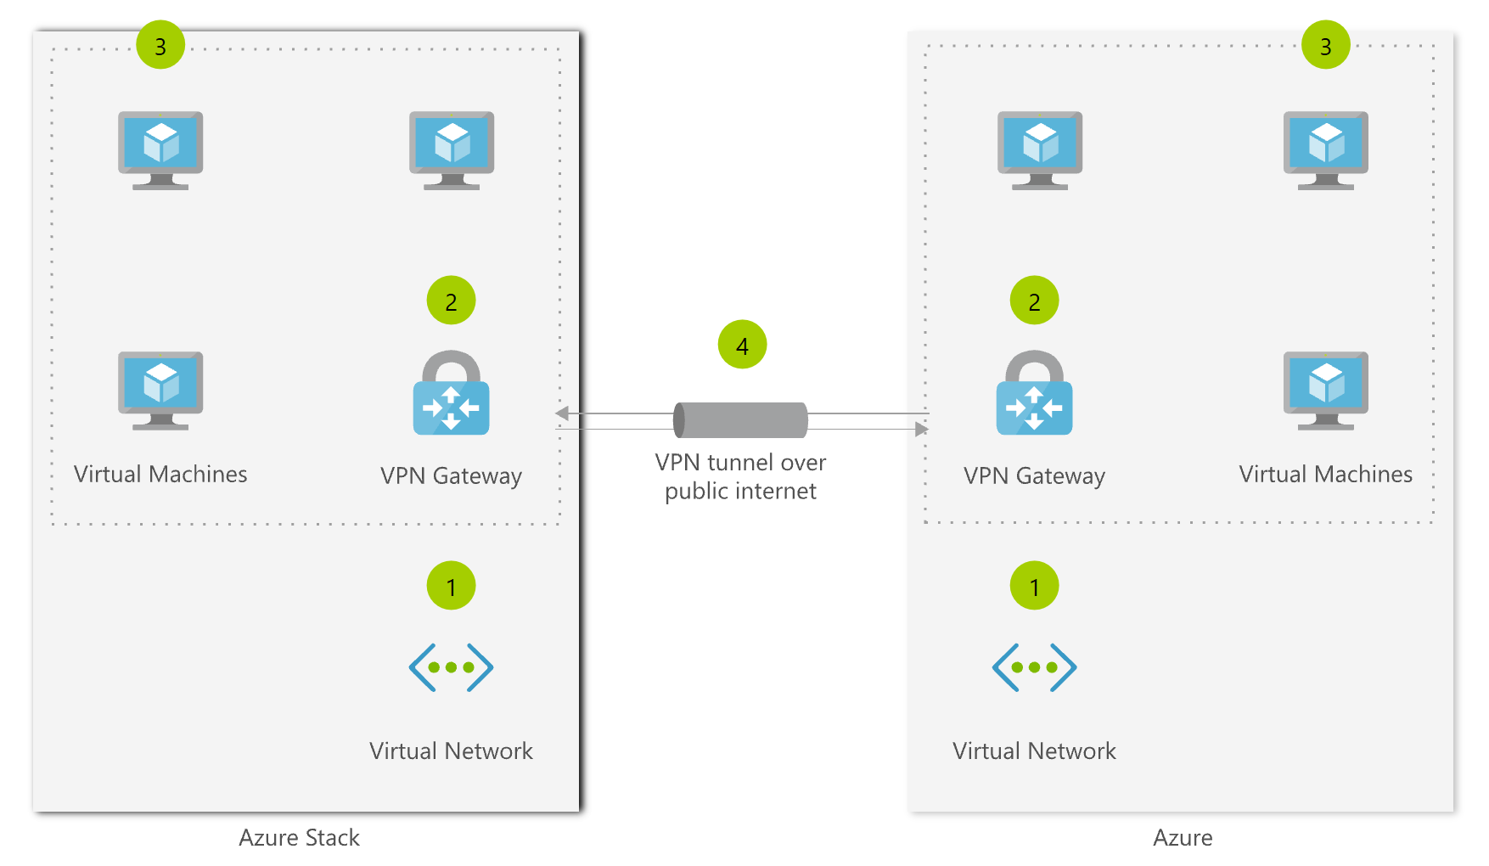
Hybrid Solution Architectures
Page 19
Hybrid connectivity
❶ Deploy a virtual network in Azure and Azure Stack Hub
❷ Deploy a virtual network gateway in Azure and Azure Stack Hub.
❸ Deploy virtual machines in each virtual network
❹ Establish a VPN connection over the public internet between the network gateways

Slide 20
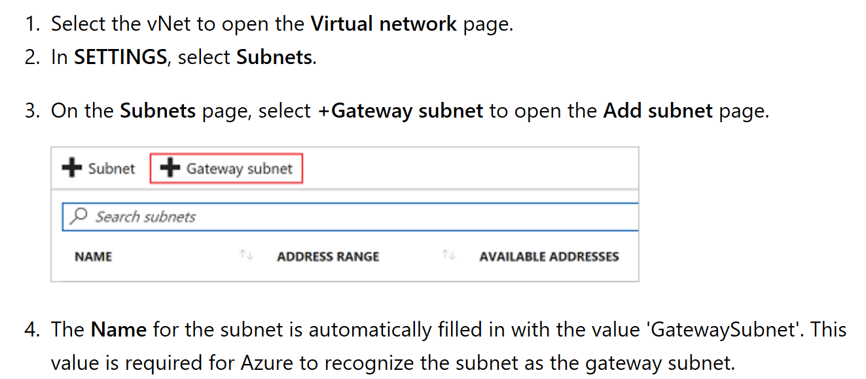
Hybrid Solution Architectures
Page 20
Hybrid connectivity – Step by step
Detailed instructions for setting up site to site VPN between Azure Stack Hub and Azure are here - https://docs.microsoft.com/en-us/azure/azure-stack/user/azure-stack-solution-hybrid-connectivity

Slide 21
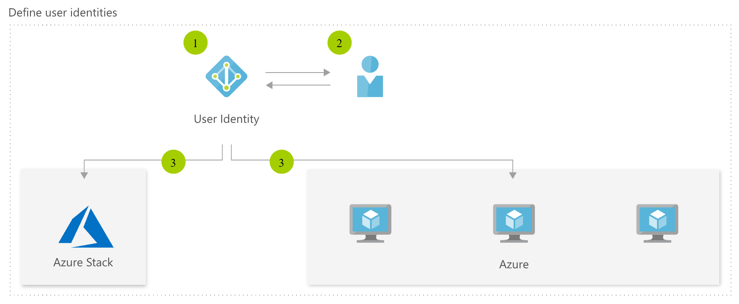
Hybrid Solution Architectures
Page 21
Hybrid identity - users
❶ Set up an Azure Active Directory tenant
❷ Create users
❸ Deploy, manage, and operate application resources on Azure and Azure Stack Hub

Slide 22
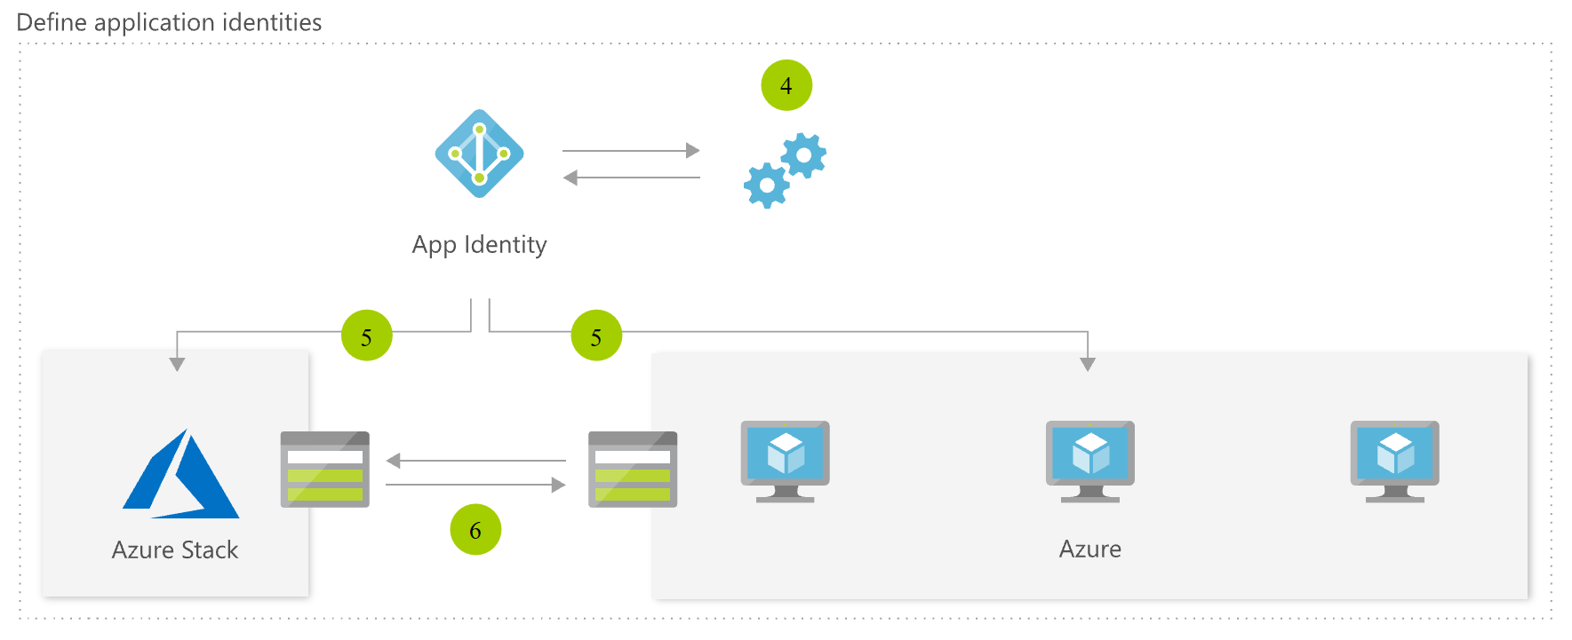
Hybrid Solution Architectures
Page 22
Hybrid identity – service principles
❹ Create service principles
❺ Deploy with service principles
❻ Application resources can communicate over network

Slide 23
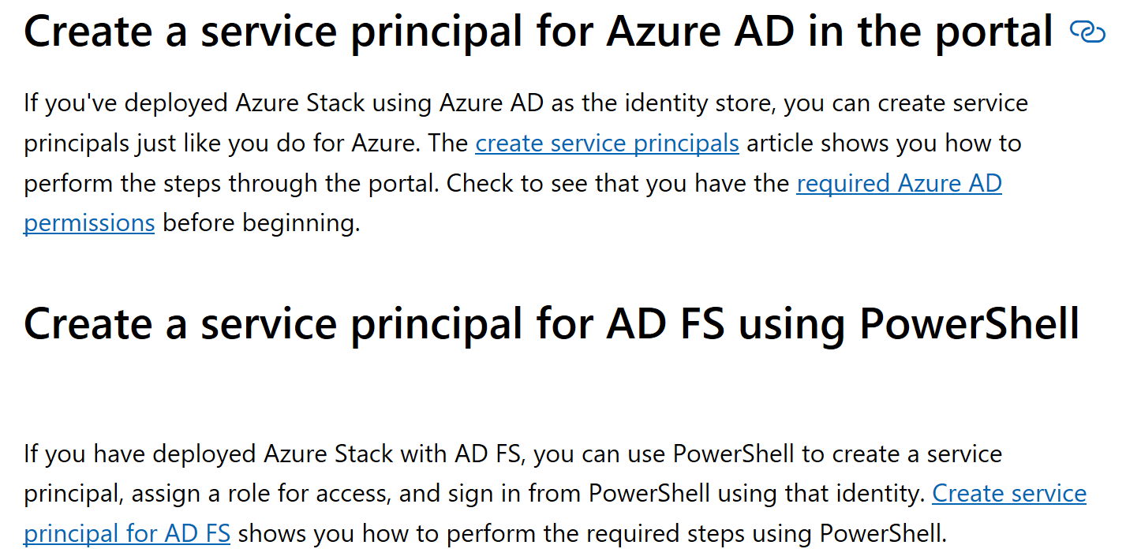
Hybrid Solution Architectures
Page 23
Hybrid identity – Step by step
Detailed instructions for setting up hybrid identity service principal for use between Azure and Azure Stack Hub are here - https://docs.microsoft.com/en-us/azure/azure-stack/user/azure-stack-solution-hybrid-identity

Slide 24
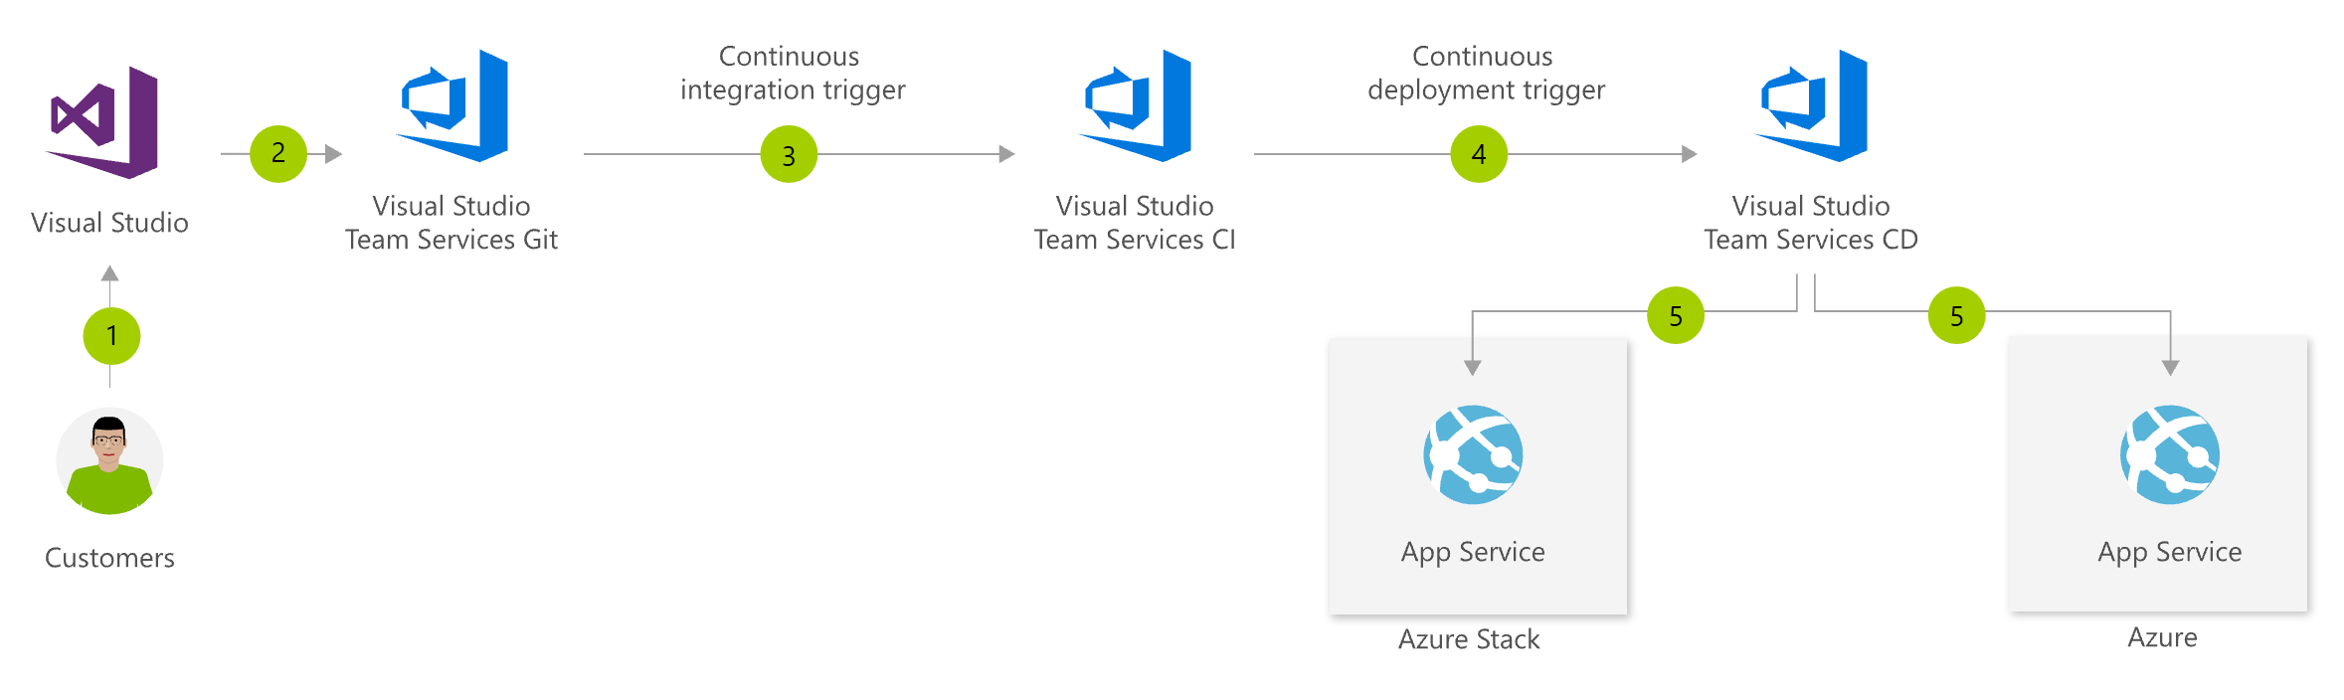
Hybrid Solution Architectures
Page 24
Hybrid CI/CD pipeline
❶ Engineer makes changes to application code and ARM template
❷ Code and ARM template are checked into Visual Studio Team Services Git ❸ Continuous integration triggers application build and unit tests
❹ Continuous deployment trigger orchestrates deployment of application artifacts with environment-specific parameters
❺ Deployment to App Service on both Azure and Azure Stack Hub

Slide 25
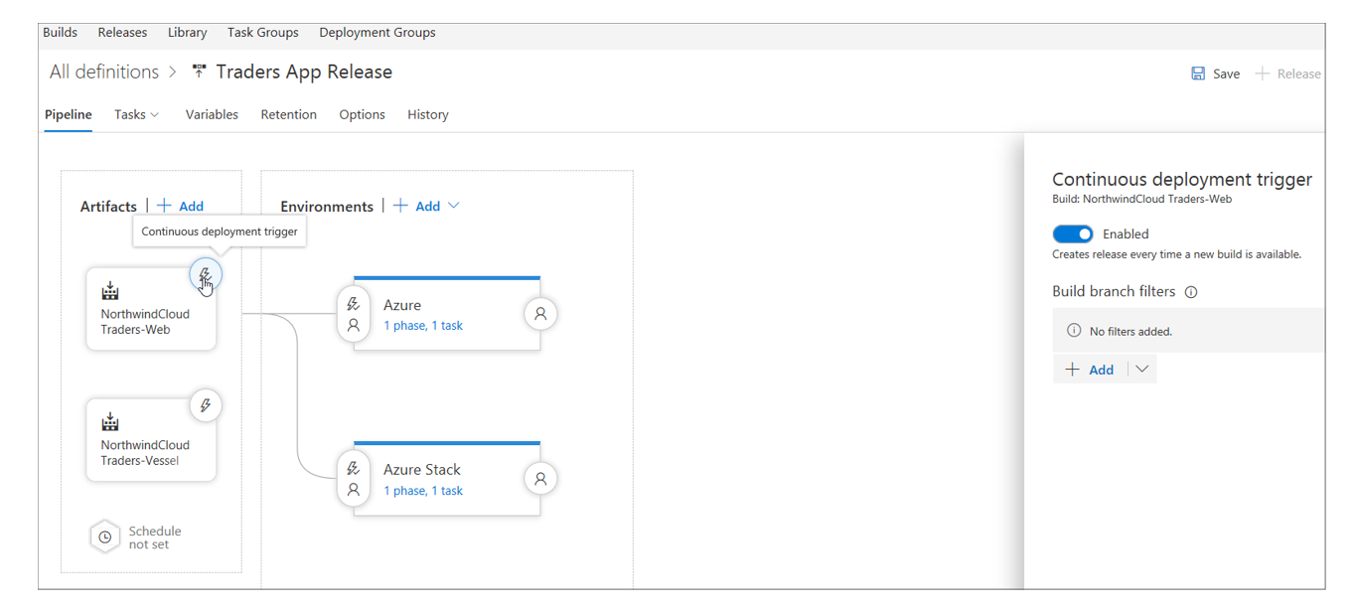
Hybrid Solution Architectures
Page 25
Hybrid CI/CD pipeline – Step by step
Detailed instructions for setting up CI/CD from Visual Studio to Azure Stack Hub are here - https://docs.microsoft.com/en-us/azure/azure-stack/user/azure-stack-solution-pipeline
The pattern deploys an application to Azure and then to Azure Stack Hub once it has passed testing

Slide 26
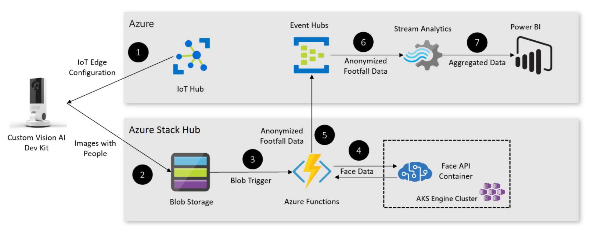
Hybrid Solution Architectures
Page 26
Footfall detection pattern
Patten for implementing an AI-based footfall detection solution for analyzing visitor traffic in retail stores
The solution generates insights from real world actions, using Azure, Azure Stack Hub, and the Custom Vision AI Dev Kit.

Slide 27
Hybrid Solution Architectures
Page 27
Footfall detection pattern | Step by step
❶ Deploy Hyrbid Cloud App
❷ Prepare the Custom Vision AI DevKit ❸ Deploy the Camera App
❹ Configure Azure Stream Analytics
❺ Create a Power BI Dash Board
Deploy AI-based footfall detection solution in Azure and Azure Stack Hub - Azure Hybrid App Solutions | Microsoft Docs
The pattern
Deploys Cloud Native Application Bundles (CNAB) at the edge.
Deploys an app that spans cloud boundaries.
Uses the Custom Vision AI Dev Kit for inference at the edge.

Slide 28
Hybrid Application Tutorials

Slide 29
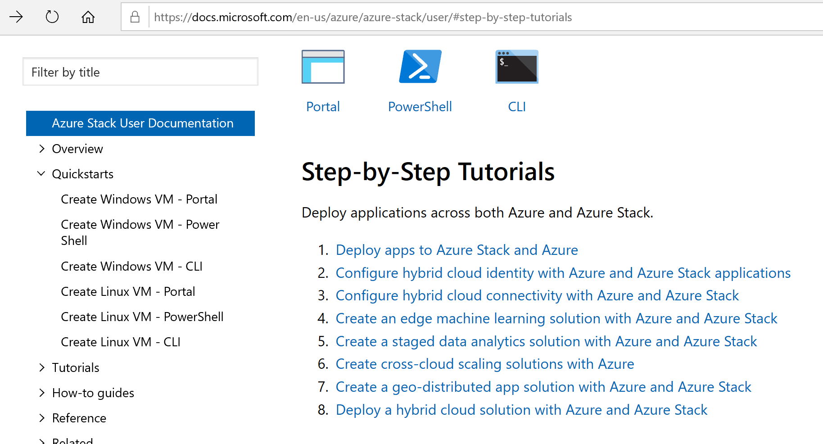
Guidance and artifacts
https://aka.ms/azsdevtutorials

Slide 30
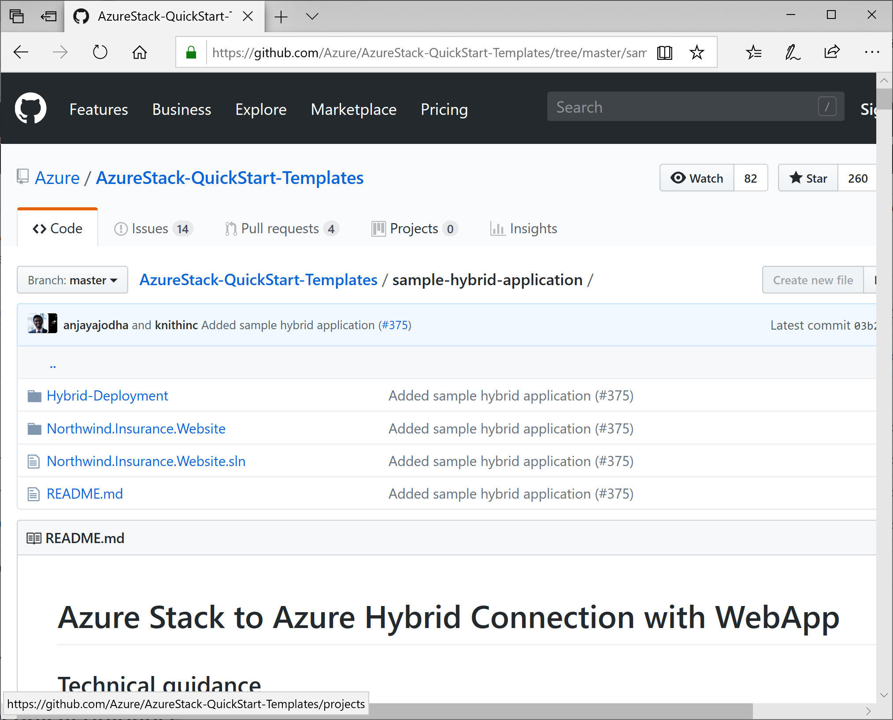
Guidance and artifacts
First releases in a series
Reference scripts and templates
Showcase Azure to Azure Stack Hub hybrid connections
https://aka.ms/azshybridsample

Slide 31
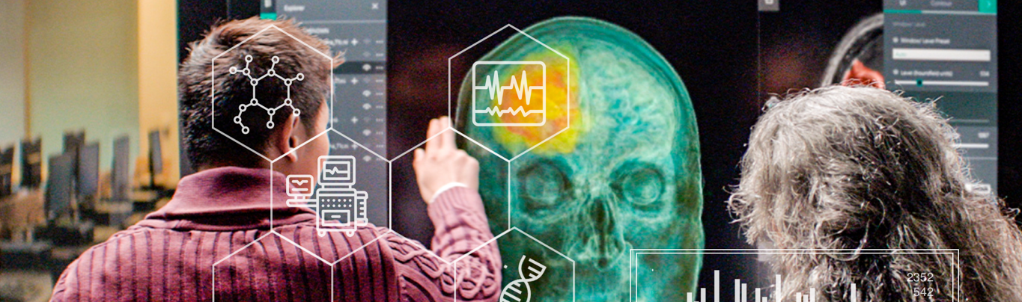
Hybrid cloud solutions
Hybrid DevOps
Cross-cloud scaling
Data sovereignty and gravity
AI at the edge
Geo-distributed applications
Tiered data for analytics
Azure hybrid and multicloud patterns and solutions documentation | Microsoft Docs

Slide 32






Complete hybrid solution
Users are automatically directed to the most compliant cloud
Data is stored on Azure Stack Hub
Hybrid developer uses a hybrid CI/CD pipeline to maintain consistent deployments
Azure
1
2
3
Azure Stack Hub

Slide 33
Complete Hybrid Solution
Users are automatically directed to the most compliant cloud
Data is stored on Azure Stack Hub
Hybrid developer uses a hybrid CI/CD pipeline to maintain consistent deployments
Azure
1
2
3
Azure Stack Hub

Slide 34
Complete Hybrid Solution
Users are automatically directed to the most compliant cloud
Data is stored on Azure Stack Hub
Hybrid developer uses a hybrid CI/CD pipeline to maintain consistent deployments
Azure
1
2
3
Azure Stack Hub

Slide 35

Hybrid DevOps
Portable cloud-native applications and infrastructure
Use the same tools across cloud boundaries
Extend Azure for specialized needs

Slide 36

Hybrid DevOps
Changes to application code and ARM template
Code and ARM template checked into Azure Repos
Automatic application build and unit tests
Orchestrated deployment of application artifacts with environment-specific parameters
Application runs on App Service on both Azure and Azure Stack Hub
2
3
4
5
1
App service
App service
Azure Stack Hub
Azure

Slide 37

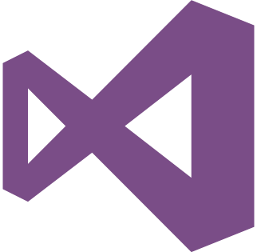

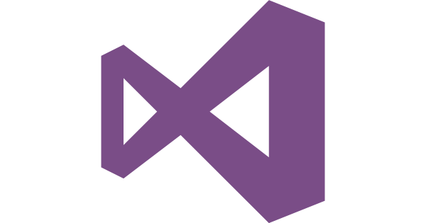


Hybrid DevOps
VSTS
Azure
Git Repository (App)
Azure hosted Build Agent (primary)
Azure release (hosted)
Web App
Template output
Azure release (local)
Git Repository (ARM)
Azure hosted Build Agent (copy to staging)
Azure release (hosted)
Azure Stack Hub
Tenant
Admin
Azure release (local)
Build Agent
Images
App Services
Web App
Template output
SPN
Offers and plans
SQL Resource Provider

Slide 38
Hybrid DevOps
Considerations and best practices
Use service principals to enable authorization to each environment
Use self-hosted Azure Devops agents for faster build and deployment times
Allow for connectivity between application parts or Azure and the agent
Ensure that all services and images are available on each target Stack
Use profiles to minimize work to deploy to two environments

Slide 39

Cross-cloud scaling
Scale application to meet your customer demands easily
Increased flexibility and resiliency with Azure Stack Hub consistency
Consistent experiences across cloud boundaries

Slide 40

Cross-cloud scaling
Users attempt to access the web app
Traffic manager returns the Azure Stack DNS name
Users load the Azure Stack Hub web app
Once a threshold is reached, a function starts the Azure Web App and enabled the Azure Traffic Manager Route
Traffic is routed to Azure
Azure
5
1
4
2
Azure Stack Hub
3

Slide 41

Cross-cloud scaling
Azure
Custom domain
SSL
External user web browser
Hosted Build Server
Azure Stack Hub
Custom domain
Azure Stack Hub Build Server
SSL

Slide 42
Cross-cloud scaling
Considerations and best practices
Properly acquire SSL certificates and domains to maintain a secure connection
Use an Azure Pipeline agent on each environment to deploy faster
Ensure there are enough dedicated App Service workers to support the application
Ensure that the Azure Stack Hub is routable from the Internet
Configure autoscaling rules in Azure for true cloud-native scaling

Slide 43

Data sovereignty and data gravity
Bring applications and services to where data resides
Create robust applications that span across cloud boundaries
Meet regulatory, data privacy, and compliance requirements

Slide 44
Data sovereignty and data gravity
User enters data into Azure-based web app
Application commits data to database over VNet to VNet VPN connection to Azure Stack Hub
Data is stored in SQL database on VM in Azure Stack Hub
Azure
Azure Stack Hub
1
2
3

Slide 45

Data sovereignty and data gravity
Azure
Corporate Network
Azure Stack Hub—Tenant
Web App
Azure Public IP
Azure Public IP
Database Server
FIREWALL
Jump Host
Virtual Network 10.10.102.0/23
App Subnet: 12.10.102.0/24
Gateway Subnet 10.10.0.103.0/24
Virtual Network Gateway
Virtual Network 10.10.100.0/23
App Subnet: 10.10.100.0/24
Gateway Subnet 10.10.0.101.0/24
Ipsec IKE S25 VPN
Azure Stack Hub S25
Local Network Gateway
10.10.100.0/23
+Azure Stack Hub Public IP
Connection
Hybrid Connection
Connection
Azure Stack Hub S25
Local Network Gateway
10.10.102.0/23
+Azure Public IP

Slide 46
Data sovereignty and data gravity
Considerations and best practices
Make sure that none of the subnets in the virtual networks overlap
Use ARM Templates to reliably deploy infrastructure machines
Ensure that data storage requirements are being met on-premises depending on the use case
Ensure that the Azure Stack Hub is routable from the Internet
Use a strong pre-shared key to set up the VPN

Slide 47

AI at the edge
Bring intelligence and computing power to where your data originates
Train models at scale— deploy models on-premises
Get faster insights with inference at the edge

Slide 48

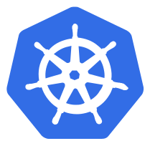


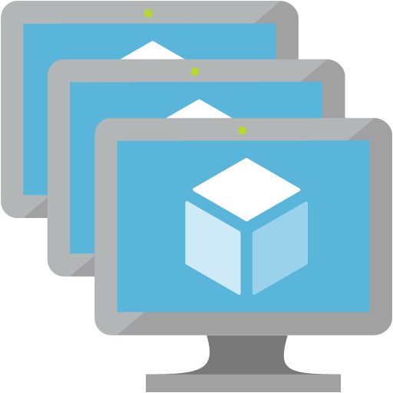
AI at the edge
A model is trained in the cloud using Azure ML tools and containerized
The model is deployed to a Kubernetes cluster on Azure Stack Hub
Input is scored against the model
Insights from scoring are placed into a queue
Compliant data and insights are sent to Azure
Global insights are available in the global app
Data from edge scoring is used to improve the model
Azure
Azure Stack Hub
1
2
3
7
5
4
6

Slide 49

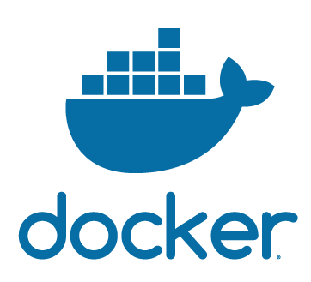

AI at the edge
VSTS
Azure Stack Hub
</>
Scoring and anonymous and send to Azure f(x)
Build definition
Release definition
Private build agent
App Service
YAML
Build definition
Release definition
Developer
Sensitive data
Azure
Score and anonymous f(x)
AML Workbench
Training
Data Science Virtual Machine (sensitive data)
Azure Container Registry
ACS Kubernetes cluster
(as Docker image)
Anon data
Machine Learning Experimentation
Data scientist
Model and Python
Container image
Deploy
Machine Learning Model Management
Storage container
Send to Azure f(x)
Storage queue
Anon data

Slide 50
AI at the edge
Considerations and best practices
Make sure that Kubernetes is deployed on the target Azure Stack Hub, and that the cluster is properly networked.
Plan for an unreliable internet connection when uploading data or deploying a new model
Appropriately scale the training cluster in Azure
Ensure the scoring application is protected against a denial-of-service attack

Slide 51

Geo-distributed applications
Deploy modern serverless applications and microservices globally
Provide compliant services for users worldwide
Enable seamless connections with Azure services
Geo-distributed app pattern in Azure Stack Hub - Azure Hybrid App Solutions | Microsoft Docs

Slide 52
Geo-distributed applications
Users attempt to access application
DNS queries Traffic Manager
Traffic Manager returns the application (Azure or Azure Stack Hub) that’s closest to the user
Azure
3
Azure Stack Hub (EU)
1
2
Azure Stack Hub (Africa)

Slide 53
Geo-distributed applications
Query
Azure Stack Hub endpoint 1 (EU)
Azure Stack Hub endpoint 2 (Africa)
Azure endpoint (All other locations)

Slide 54
Geo-distributed applications
Considerations and best practices
Make sure that SSL certificates and domain names are properly configured
This solution doesn’t accommodate for scalability of the solution, but it can be incorporated
Use a hybrid DevOps pipeline to reliably deploy applications to all clouds
Use either app code, or geolocation to accurately route end users

Slide 55

Tiered data for analytics
Overcome latency challenges by optimizing data
Bring cloud first development model close to data
Derive business insights across a “fleet” of systems

Slide 56
Tiered data for analytics
Data flows into a storage account
Function on Azure Stack Hub analyzes the data for anomalies or compliance
Locally-relevant insights are shown
Insights and anomalies are placed into a queue
Function sends data from queue to Azure storage
Global insights are available in the global app
Azure Stack Hub
Azure
4
6
2
1
7
3

Slide 57

Tiered data for analytics
Azure Stack Hub
Azure
Storage account
Function
Storage queue
Function
Storage
Anonymized data
Analyzed data
Archive
Data
Global Apps
Local application

Slide 58
Tiered data for analytics
Considerations and best practices
Plan for intermittent or disconnected scenarios when writing application code
Ensure that non-compliant data is stored encrypted at rest either in Azure Storage or another platform
Scale Azure Functions and applications appropriately

Slide 59
A Peek Inside a Tutorial

Slide 60
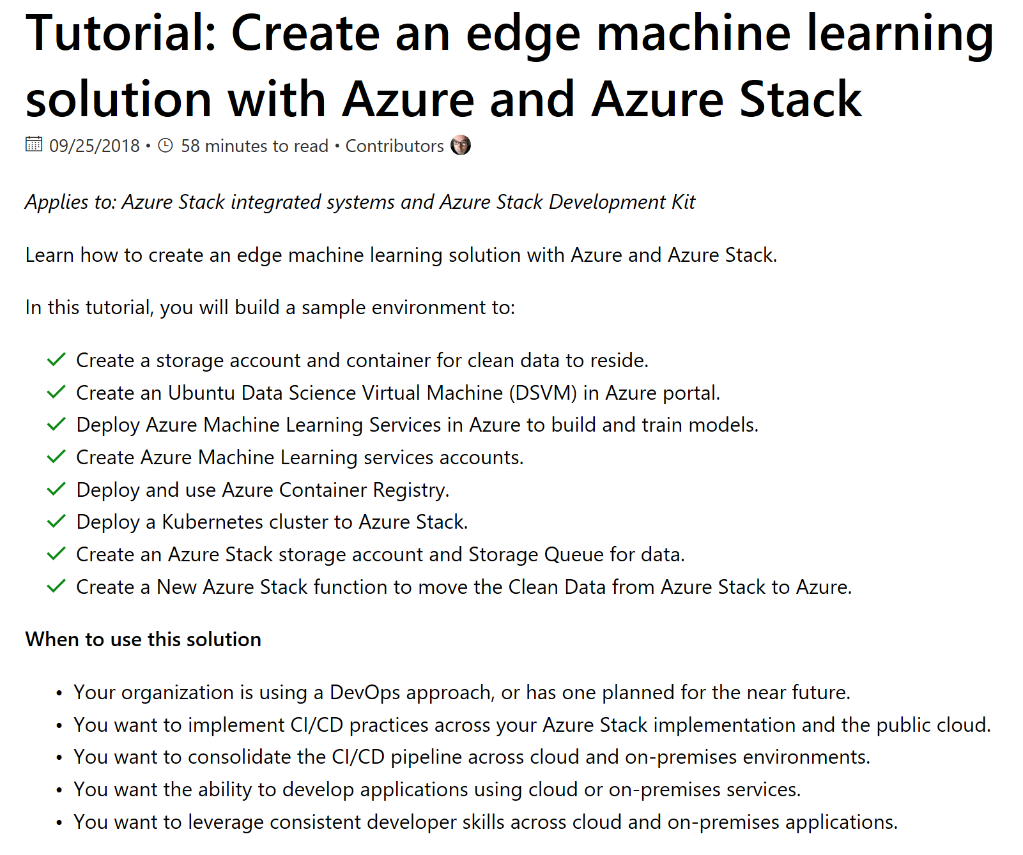
Drill down: Edge machine learning solution

Slide 61
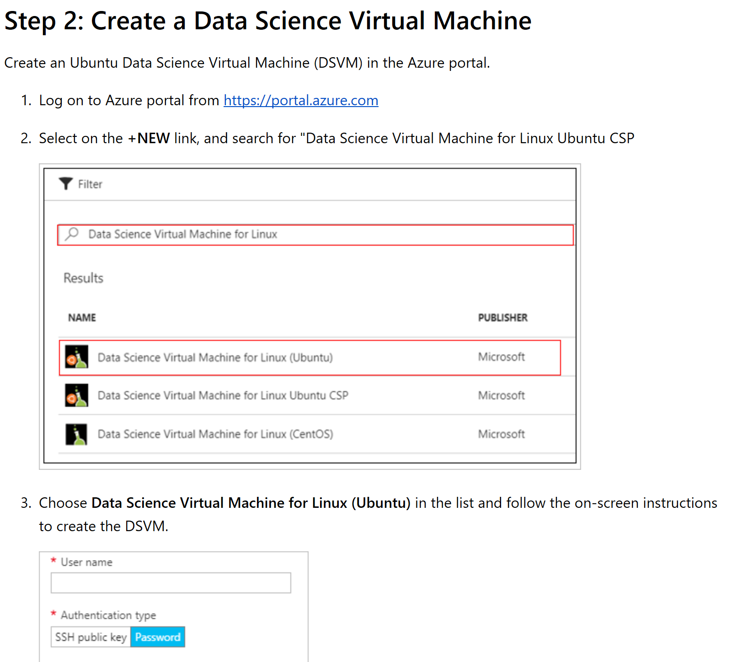

Slide 62
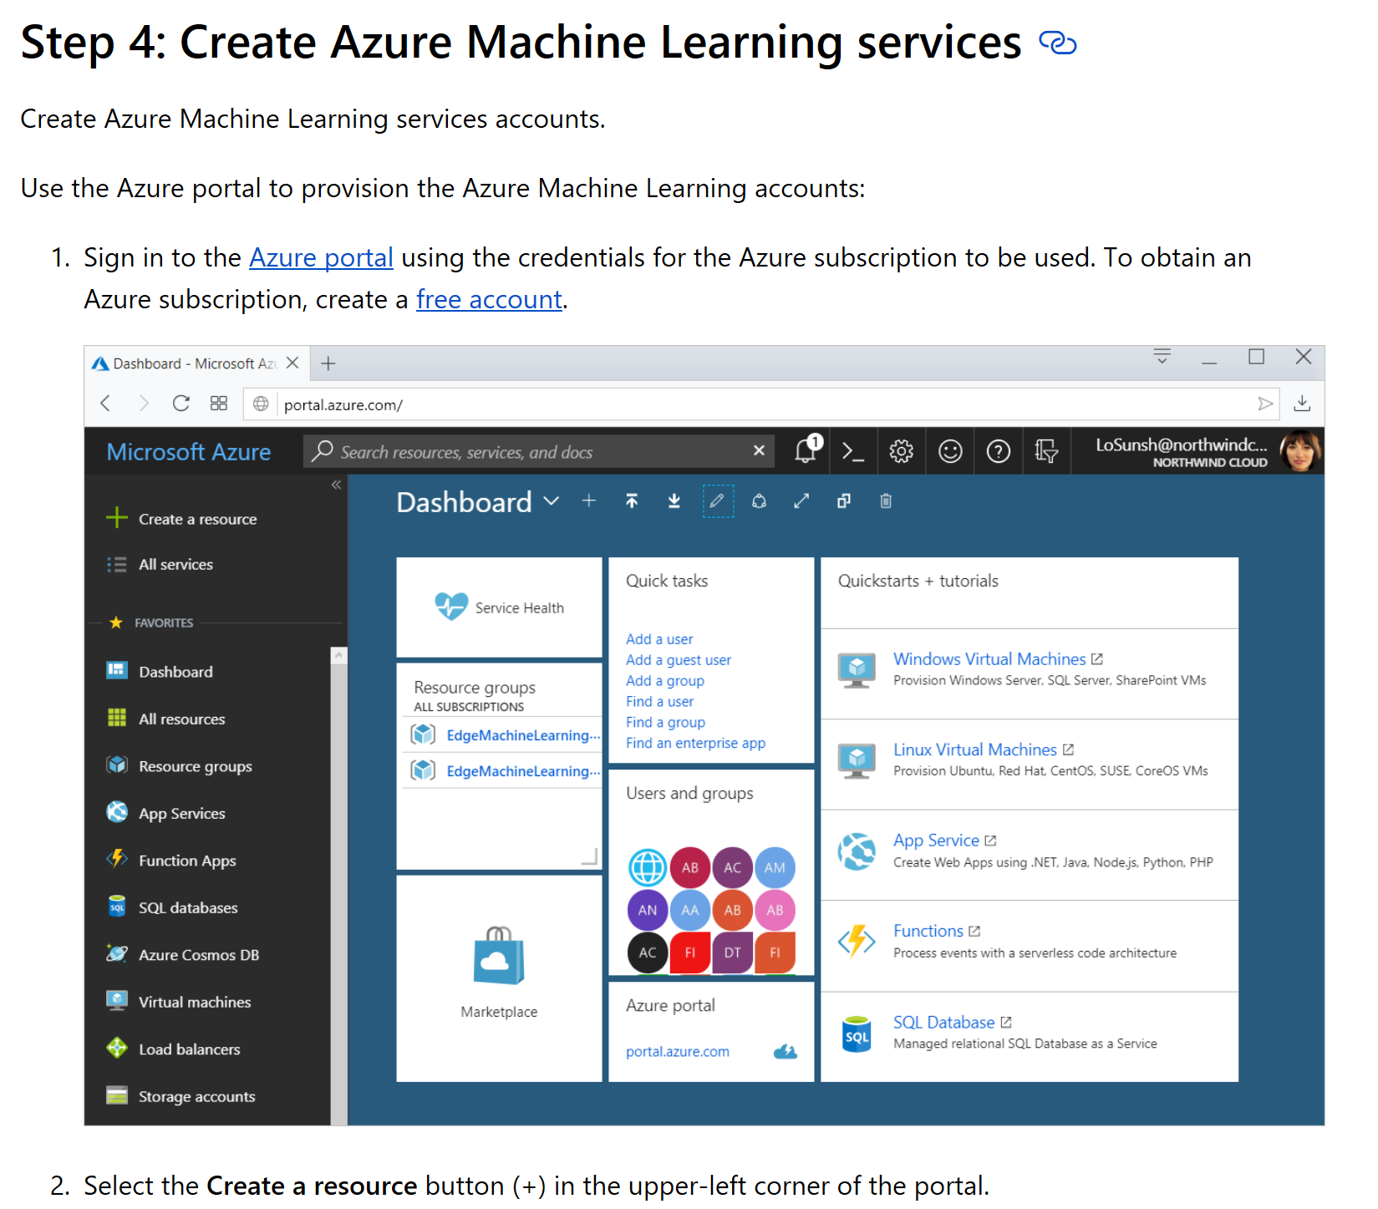

Slide 63
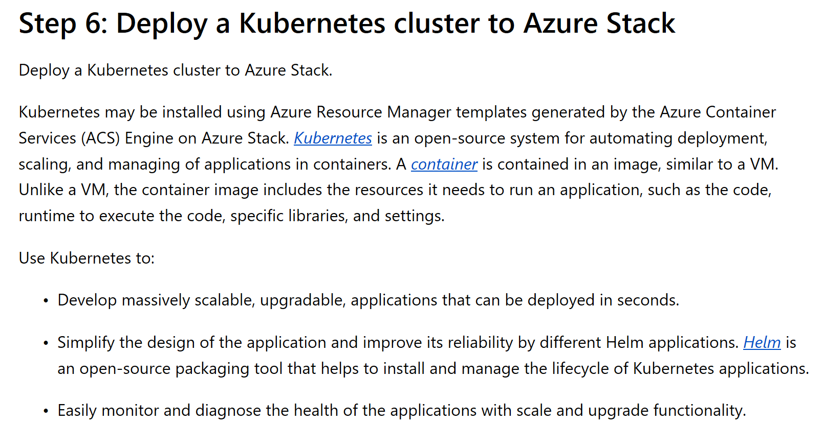

Slide 64
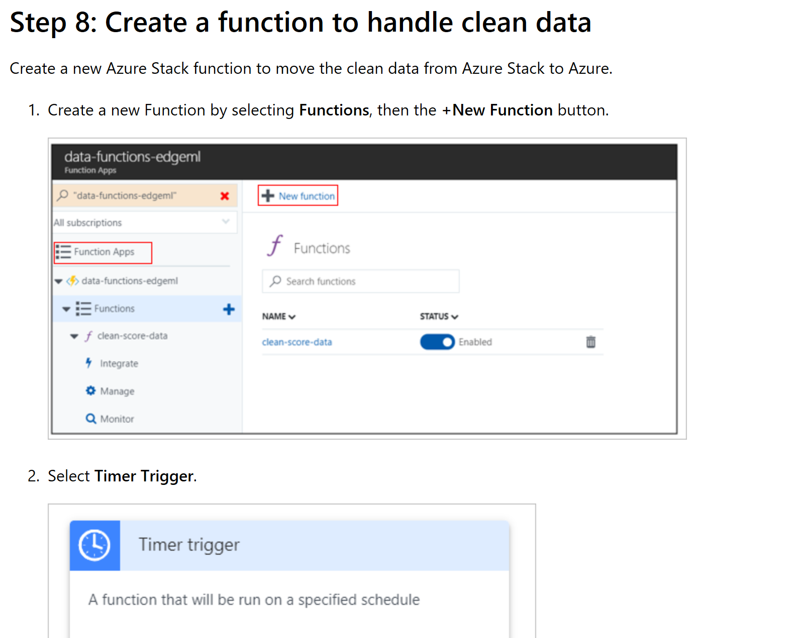

Slide 65
Tooling and Developer Tips

Slide 66
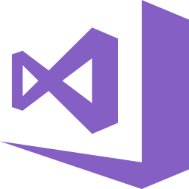

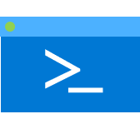




Develop
Visual Studio Tools
Visual Studio Cloud Explorer
Azure Tools
Deploy and Manage
Trusted
Consistent Tooling across clouds
Productive
Intelligent
Hybrid
Azure CLI
Azure SDKs (.Net, Java etc…)
Azure PowerShell
Azure Storage Explorer
Monitor
Log Analytics
Application Insights

Slide 67
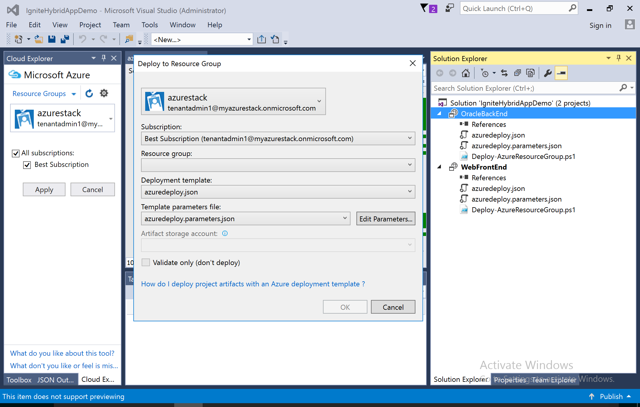
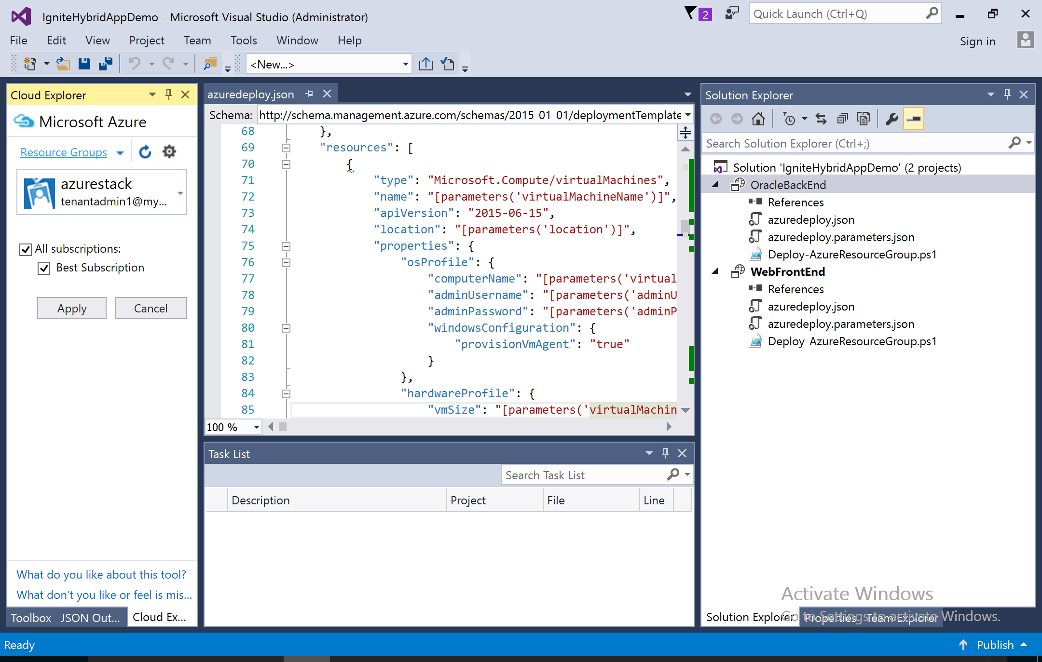
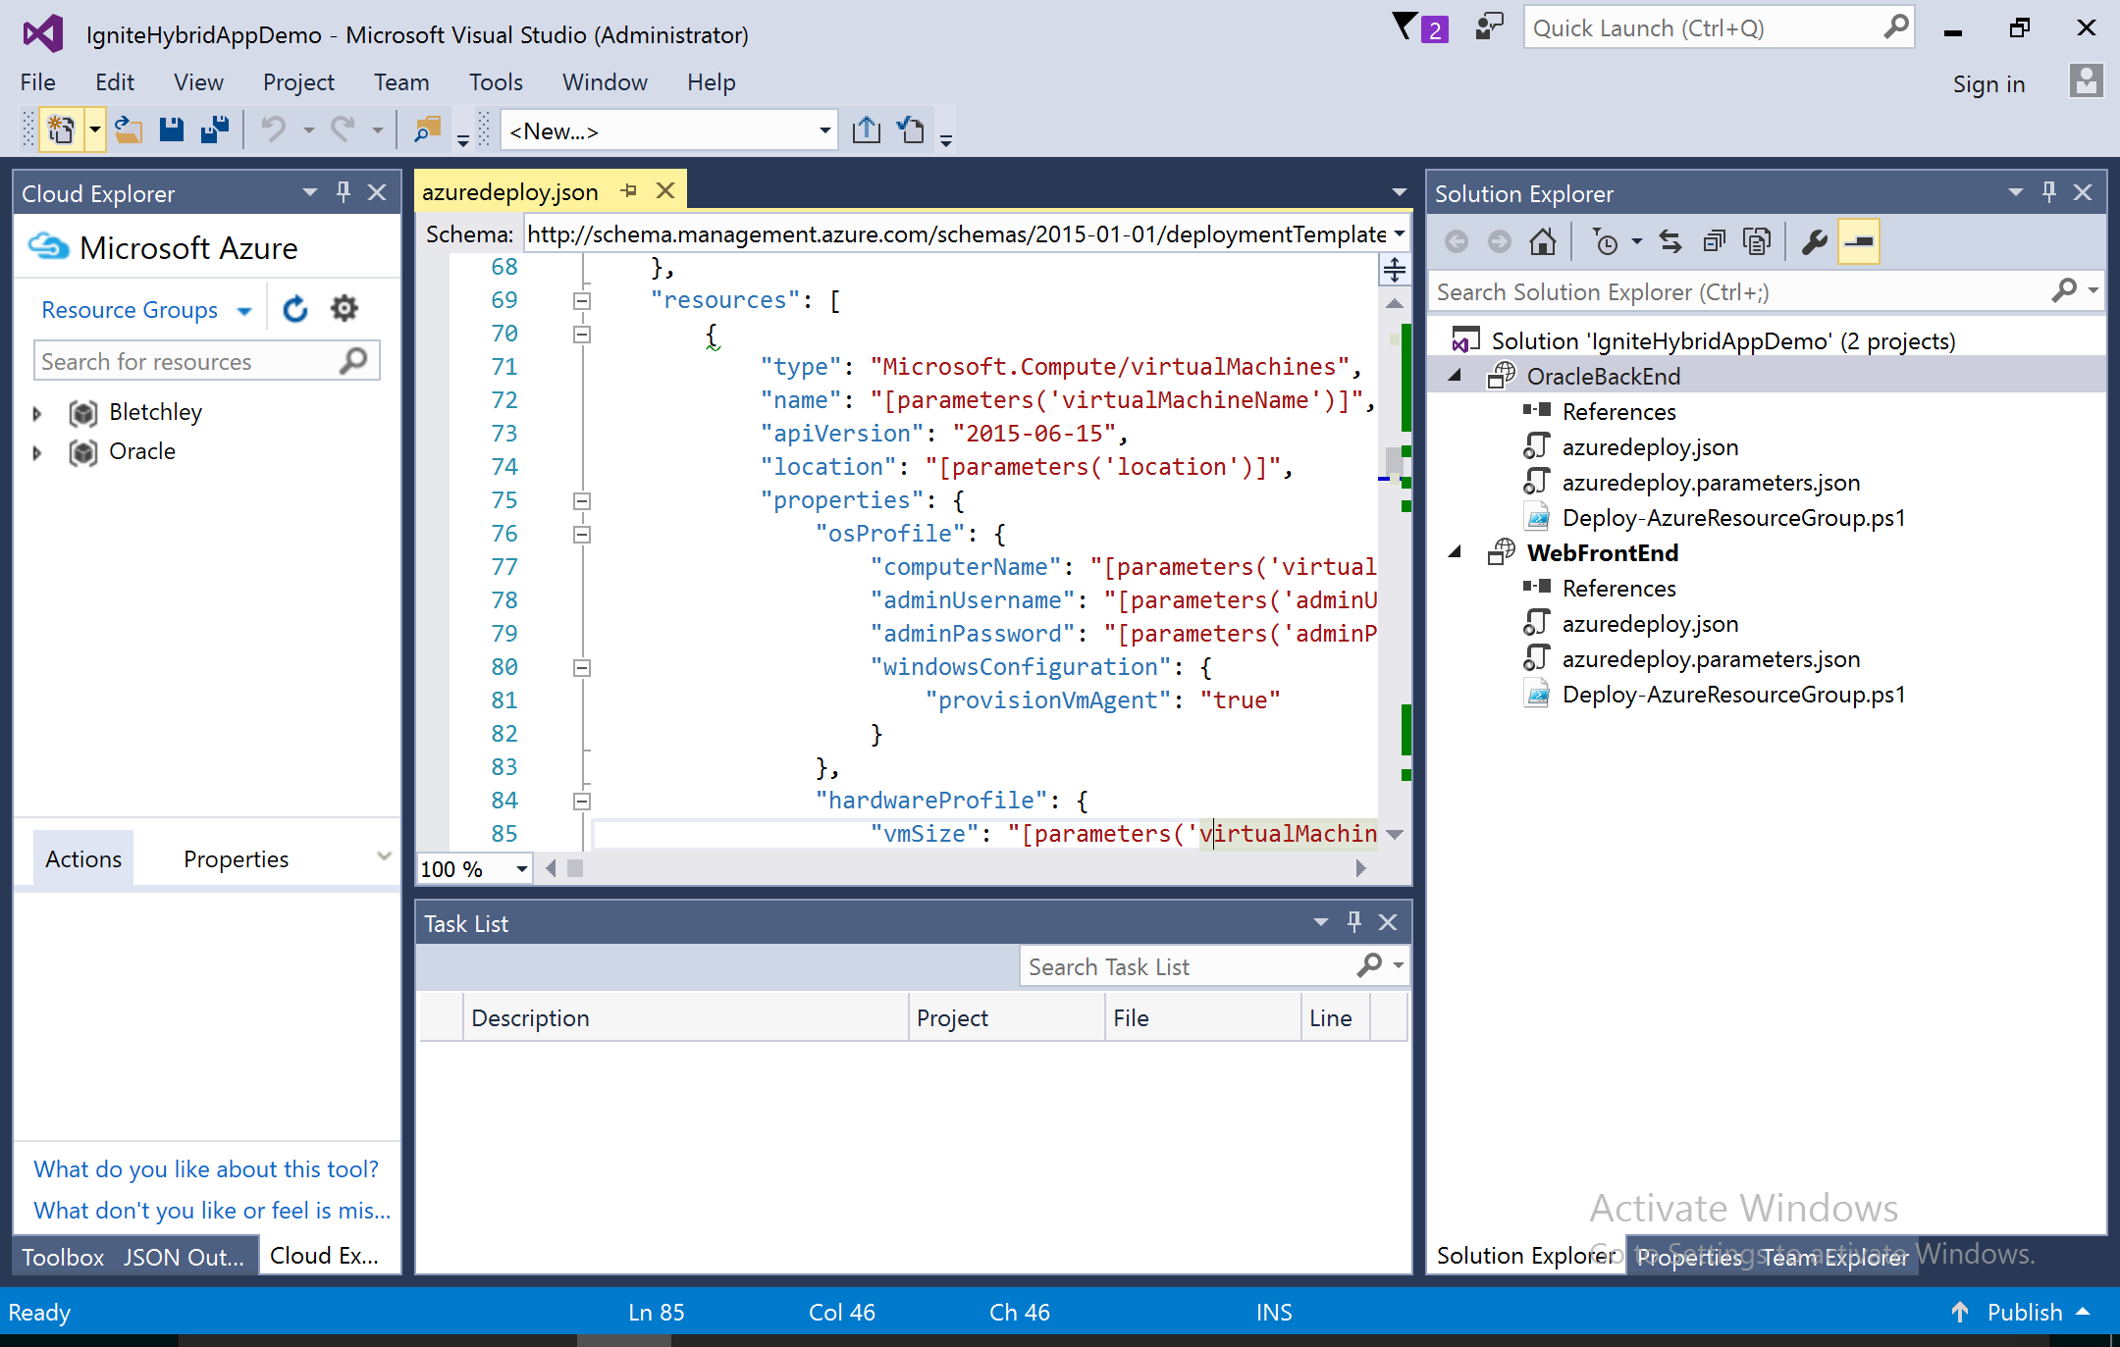
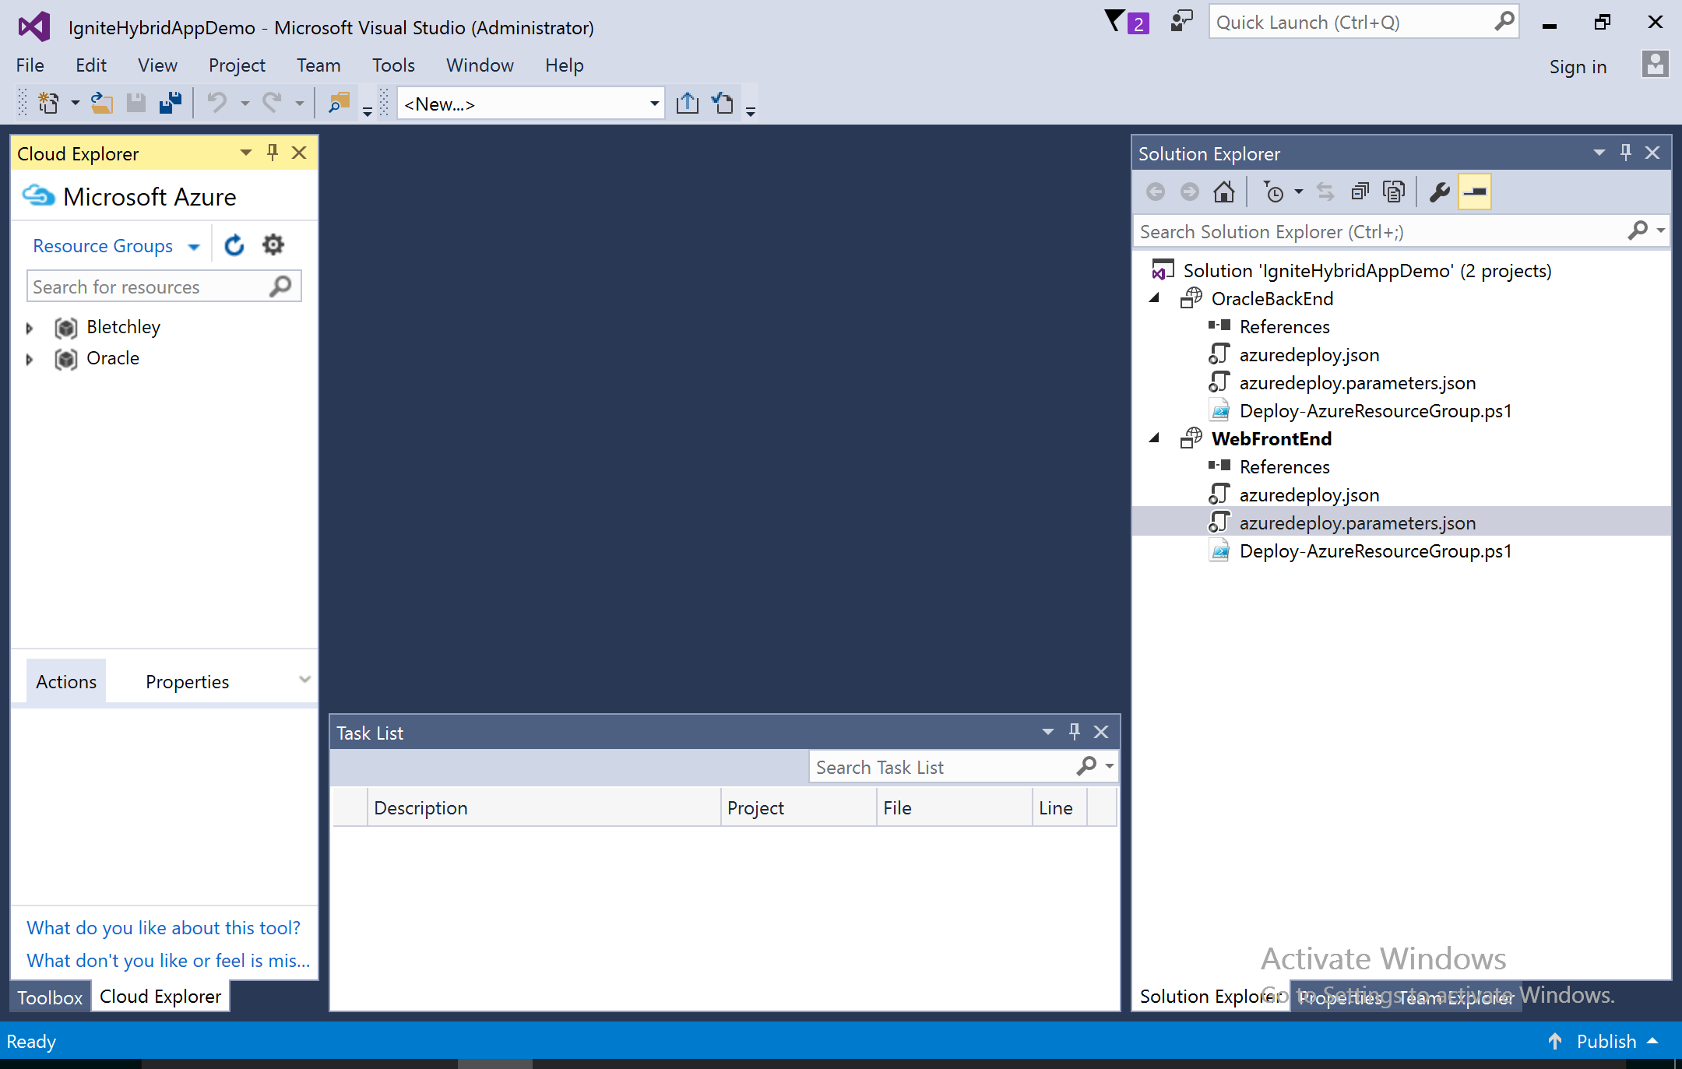
Visual studio

Slide 68

Showstoppers when developing hybrid cloud solutions
“Special” ARM Templates
Hardcoded deployment endpoints
Assuming content exists
Using unavailable features
This Photo by Unknown Author is licensed under CC BY-SA

Slide 69

Start on ASDK Will your Azure solution work on Azure Stack Hub?
Two methods to test on ASDK
Build one on your own hardware
Deploy ASDK on Azure VM project
Build either way with the POC scripts!
Start with Azure Stack QuickStart templates!
GitHub - Azure/AzureStack-QuickStart-Templates: Quick start ARM templates that deploy on Microsoft Azure Stack

Slide 70
Environments / Endpoints / API Versions / ARM API Profiles

Slide 71
Environments and endpoints
Azure Public Cloud
https://gallery.azure.com/
https://management.azure.com/
https://login.microsoftonline.com/
An Azure environment: An independent deployment of Microsoft Azure
Includes environments such as AzureCloud for global Azure, AzureChinaCloud, Azure Stack Hub deployments
Azure environments contain endpoints
REST APIs which are service endpoints that support access to a service's resources
Azure Stack Hub Cloud
https://gallery.azurestack.local/
https://management.azurestack.local/
https://login.windows.net/<AAD org ID>/
Azure China Cloud
https://gallery.chinacloudapi.cn/
https://management.chinacloudapi.cn/
https://login.chinacloudapi.cn/
Azure US Government Cloud
https://gallery.usgovcloudapi.net/
https://management.usgovcloudapi.net/
https://login.microsoftonline.com/

Slide 72
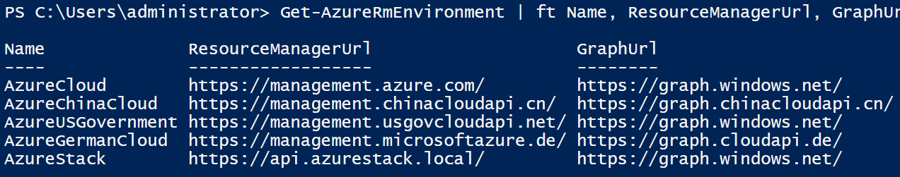
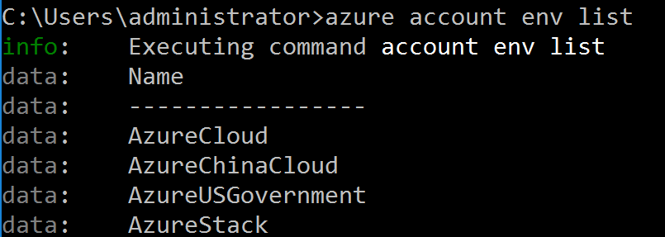
ARM endpoints
Multiple environments, different endpoints
GET https://api.azurestack.local/metadata/endpoints?api-version=1.0
{
"galleryEndpoint": "https://portal.azurestack.local:30015/",
"graphEndpoint": "https://graph.windows.net/",
"portalEndpoint": "https://portal.azurestack.local/",
"authentication": {
"loginEndpoint": "https://login.windows.net/",
"audiences": ["https://api.azurestack.local/4d771a07-77c1-4bac-924d-c9756dfd6b6c"]
}
}
An ARM template can target multiple ARM endpoints, including Azure Stack Hub.
One ARM template could deploy a solution with some Azure Services and some Azure Stack Hub Services…

Slide 73

Demo: Retrieving Azure Stack Hub environment details using PowerShell

Slide 74
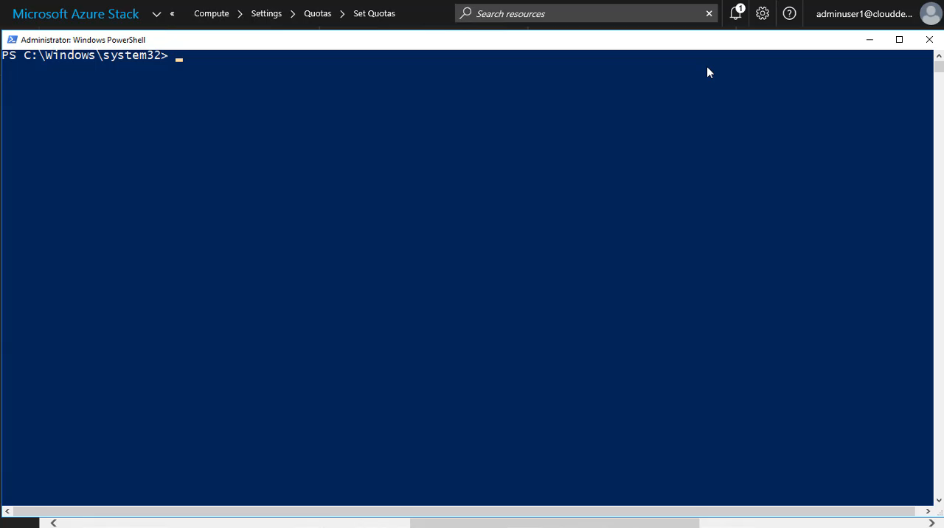

Slide 75
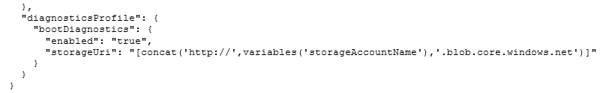
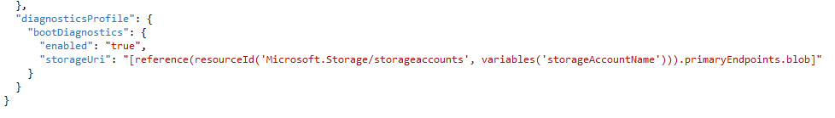
ARM endpoints Variables and parameters in ARM Templates
Azure Stack Hub APIs will be slightly behind Azure API versions. The API gap was wider at GA but is narrowing over time.

Slide 76
Identity Authentication with a service principal
Steps:
Create Service Principal in your AAD tenant using password or certificate
Assign the Service Principal a role on your subscription
Log on using password or certificate
[optional] Save access token to simplify login
For further info, refer to:
https://azure.microsoft.com/en-us/documentation/articles/resource-group-authenticate-service-principal/
Azure Stack Hub uses Azure AD for Identity – just like Azure does. You can use the same identities to grant access to Azure and Azure Stack Hub resources…

Slide 77
Azure API versions
ARM Templates, Applications, and scripts may be relevant for only certain API Versions.
Your App or Script
Azure Stack Hub APIs will be slightly behind Azure API versions. The API gap will be wider at GA but will narrow over time.
V3
V2
V1
V2
V1
Azure
Azure China
Azure Stack Hub

Slide 78
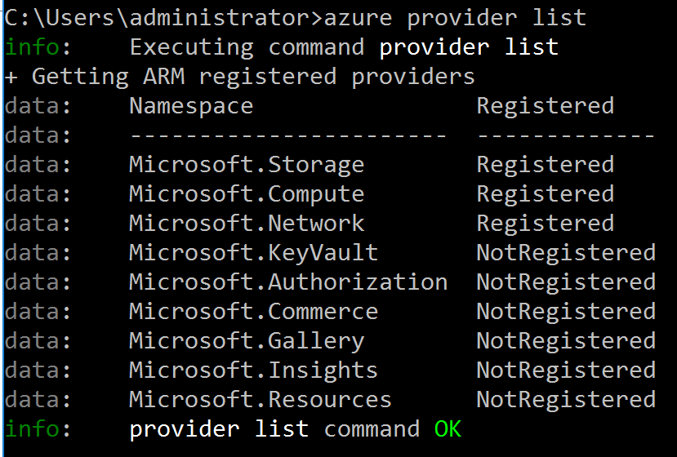
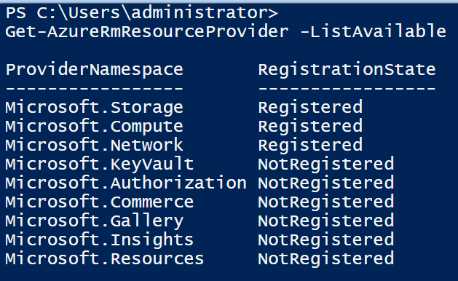
Azure API versions
GET https://management.azure.com/providers?api-version=2014-04-01-preview
{
"value": [
{
"namespace": "Microsoft.Compute",
"resourceTypes": [
{
"resourceType": "virtualMachines",
"locations": [
"East US",
…
],
"apiVersions": [
"2016-03-30",
"2015-06-15",
"2015-05-01-preview"
]
},
….
},
….
}

Slide 79
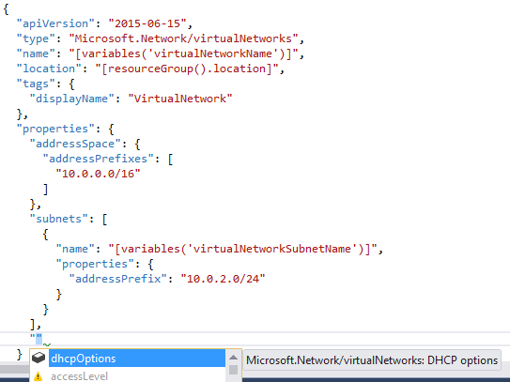
API versions

Slide 80
Hybrid app development challenges
SDK
ARM Templates
Time-consuming to find right libraries/modules to write an application
Each cloud uses different libraries/modules
API versions differ across each namespace
Applications have to be recompiled for different clouds
Various clouds have different API versions
Specifying individual API versions for the different cloud targets is complicated

Slide 81
The solution: ARM API profiles
A Profile is used to represent a set of Namespaces and their API versions.
It is a representation of us as an Azure Platform declaring a set of APIs to be supported across all our clouds.
Specify a profile version that applies to the entire template
So that you don’t need to worry about which are the right resource versions to specific clouds.
This functionality goes beyond ARM, it includes tooling support (PowerShell, CLI and SDK) as well as Visual Studio. Profiles help make that process easier by serving as a dictionary which conveys to tools and SDK’s what versions of modules/libraries need to be included while building the application.

Slide 82
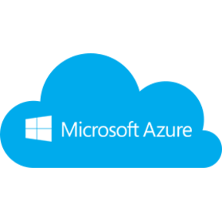
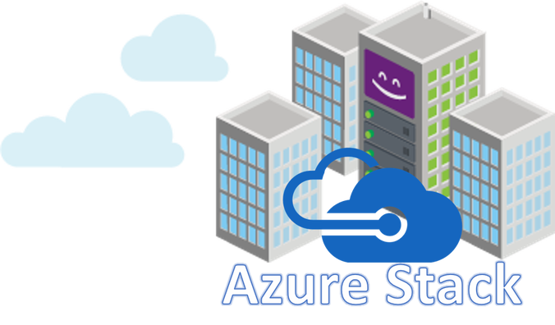
Defining API profiles
API Profiles are used to represent a set of Namespaces and their API versions.
It is a representation of Azure Stack Hub as an Azure Platform declaring a set of APIs to be supported across all our clouds.
Three naming conventions are ‘latest’, ‘yyyy-mm-dd-hybrid’, ‘yyyy-mm-dd-profile’
These Profiles will be coined four times a year and will be announced during Build and Ignite.
The developer can just align the application to a profile and the tools/SDKs will themselves revert to the right API-versions as directed by the profile.
Originally created for developers to create templates across multiple Azure Clouds. Evolved to address the need of compatibility and stability.
Profiles
latest
2017-03-09-profile

Slide 83

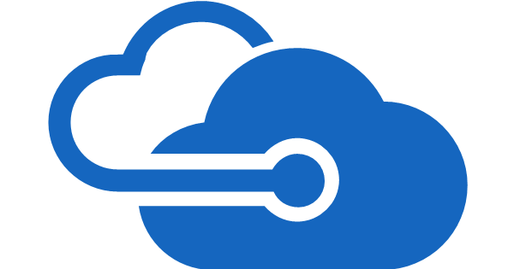
API profiles naming convention
Build, deploy, and operate applications, using API profiles on any cloud
yyyy-mm-dd-hybrid
latest
yyyy-mm-dd-profile
Most recent API versions released in Azure
Sits between optimal stability and cutting edge of “latest”
Coined two times per year, focuses on consistency and stability across multiple clouds

Slide 84

Benefits to API profiles
ARM will select the right API versions of resources at runtime
Functionality includes tooling support (PowerShell, CLI, and SDK).
Developers create application based on a Profile, it will seamlessly work across all clouds that support that Profile.
For example:
When deploying an ARM template, ARM will internally replace the Profile with individual API versions mapped to that profile for individual namespaces

Slide 85
API Profiles in PowerShell
Azure Stack Hub 1808 or later:
Use-AzureRmProfile -Profile 2018-03-01-hybrid -Force
Install-Module -Name AzureStack -RequiredVersion 1.5.0
Azure Stack Hub 1807 or earlier:
Use-AzureRmProfile -Profile 2017-03-09-profile -Force
Install-Module -Name AzureStack -RequiredVersion 1.4.0

Slide 86
ARM Templates
Use dynamic endpoints
Parameterize locations
Be flexible about VM sizes and OS images
Example: https://github.com/Azure/azure-quickstart-templates/blob/master/bosh-setup/azuredeploy.json

Slide 87
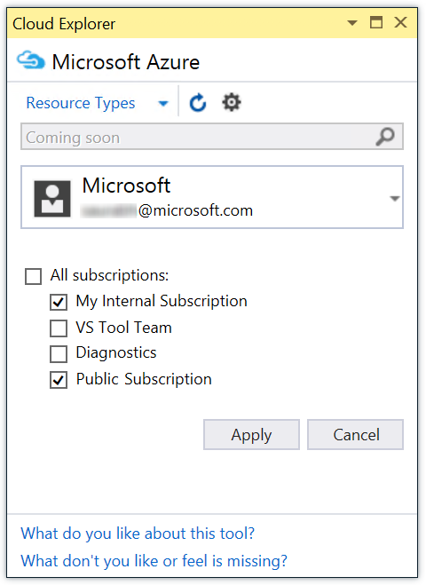
Visual Studio Tooling with API Profiles
Cloud Explorer in Azure Stack Hub is consistent with Azure
Using Profiles is available in Intellisense
Rich design-time Eeperience
Can deploy to multiple clouds that all support that profile
Published JSON schema

Slide 88
Capabilities – E.g. VM sizes
Your App or Script
A0-Ax
D0-Dy
DS0-DSz
XY
A0-Ax
D0-Dy
A0-A4
Azure
Azure China
Azure Stack Hub
Not all Azure VM sizes will be available in Azure Stack Hub…

Slide 89
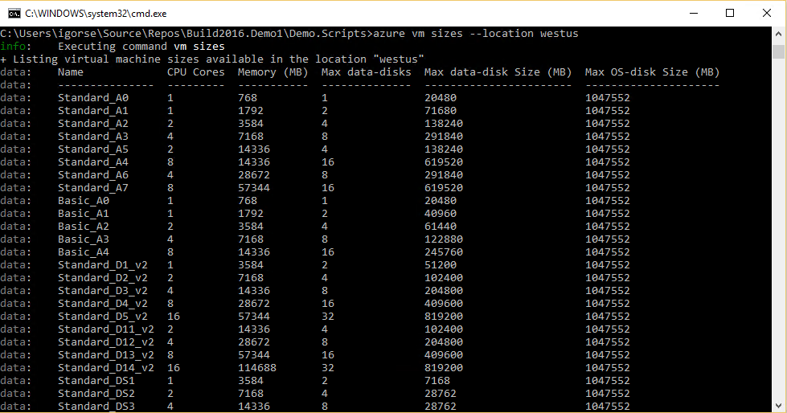

Capabilities

Slide 90
Content – E.g. images
Your App or Script
X
Y
Z
X
Y
X
Y
Azure
Azure China
Azure Stack Hub

Slide 91


Content – Extensions

Slide 92
Deployment
Use parameter files
Use Visual Studio for deployment
Azure Stack Hub Tools
Authenticate with a service principal

Slide 93
Module objectives and takeaways
Learn more about hybrid development with Azure
Learn more about the published hybrid application patterns and the services that enable them
Have conversations with your developers about these solutions and architectures
Try building these solutions by following the tutorials: https://aka.ms/azsdevtutorials

Slide 94
Module resources
Azure Stack Hub Development kit: http://aka.ms/asdk
Azure Stack Hub QuickStart templates: https://github.com/Azure/AzureStack-QuickStart-Templates
Hybrid Tutorials: https://aka.ms/azsdevtutorials
End-to-End Hybrid Application Sample: https://aka.ms/azshybridsample
1
2
3
Develop
Develop applications in Azure
Validate
Download Azure Stack Hub Development Kit
Deploy
Order Azure Stack Hub integrated systems for production deployment

Slide 95
Questions?

Slide 97
Appendix

